Slide 1
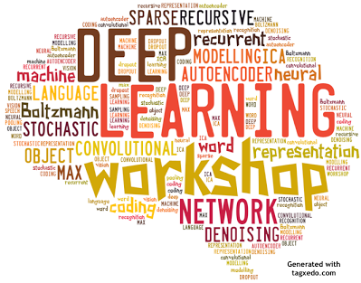
Deep Learning
An Introduction

Slide 2
Short History
60s-80s : initial research on Neural Nets
80s-early 90s: NN abandoned, other algorithms used (SVM, Trees)
Late 90s: Revival (LeCun)
2000s – (LeCun, Hinton, Bengio, Szegedy, others…)
Convolutional NN (CNN)
Autoencoders, RNN, Better and faster convergence.
GPU computing
Large data sets
Top results in Image Processing, Speech, NLP.
Large research groups in Microsoft, Google, FB, etc…
Currently – biggest hype since the Beatles.

Slide 3
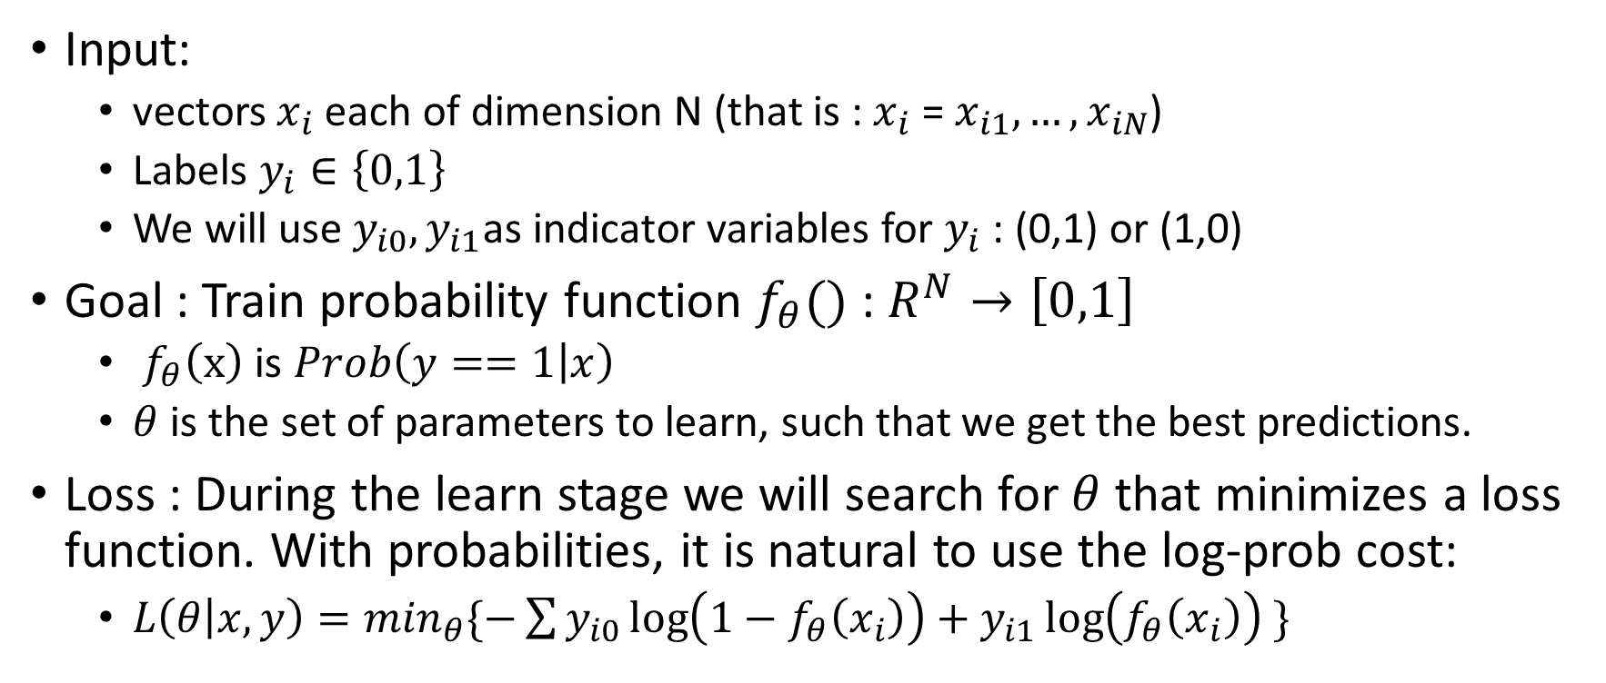
Classification by learning probabilities
Input:
vectors $x_{i}$ each of dimension N (that is :${ x}_{i}$ = $x_{i1},…, x_{iN}$)
Labels $y_{i}∈\left\{0,1\right\}$
We will use $y_{i0}, y_{i1}$as indicator variables for $y_{i}$ : (0,1) or (1,0)
Goal : Train probability function $f_{θ}()$ : $R^{N}→\left[0,1\right]$
$f_{θ}\left(x\right)$ is $Prob\left(y==1 | x\right)$
$θ$ is the set of parameters to learn, such that we get the best predictions.
Loss : During the learn stage we will search for $θ$ that minimizes a loss function. With probabilities, it is natural to use the log-prob cost:
${L\left(θ | x,y\right)=min}_{θ}\{−\sum{y_{i0}\log\left({1−f}_{θ}\left(x_{i}\right)\right)+y_{i1}\log\left(f_{θ}\left(x_{i}\right)\right)} \}$

Slide 4
Example for f : Logistic Regression
The classical single neuron is simply a logistic regression model
X – input data
h – model predicted probability
Training: using log prob cost
Typically solved with GD

Slide 5
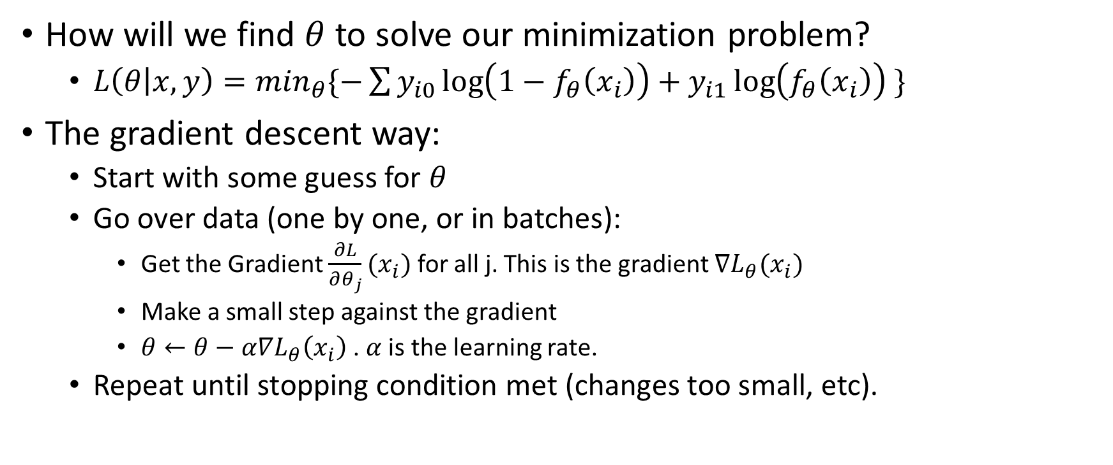
Training with Gradient Descent
How will we find $θ$ to solve our minimization problem?
${L\left(θ | x,y\right)=min}_{θ}\{−\sum{y_{i0}\log\left({1−f}_{θ}\left(x_{i}\right)\right)+y_{i1}\log\left(f_{θ}\left(x_{i}\right)\right)} \}$
The gradient descent way:
Start with some guess for $θ$
Go over data (one by one, or in batches):
Get the Gradient $\frac{∂L}{∂θ_{j}}(x_{i})$ for all j. This is the gradient $∇L_{θ}(x_{i})$
Make a small step against the gradient
$θ←θ−α∇L_{θ}\left(x_{i}\right)$ . $α$is the learning rate.
Repeat until stopping condition met (changes too small, etc).

Slide 6
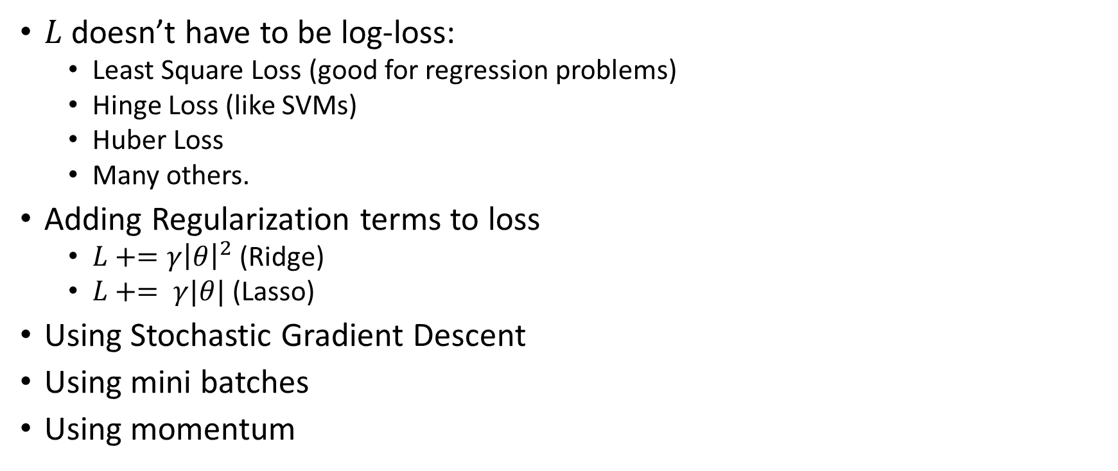
Common variants
$L$doesn’t have to be log-loss:
Least Square Loss (good for regression problems)
Hinge Loss (like SVMs)
Huber Loss
Many others.
Adding Regularization terms to loss
$L+=γ{\left|θ\right|}^{2}$ (Ridge)
$L+= γ|θ|$ (Lasso)
Using Stochastic Gradient Descent
Using mini batches
Using momentum

Slide 7
Classical Neural Nets
Stack many neurons together
Function in each node : Activation function
Train with Loss function on final output
Using Gradient Descent
In layered neural nets GD becomes Backpropagation
Neural nets are simply functions of functions
As long as we can differentiate, we can train.
Can quickly hold a large number of parameters
Can be written in Matrix form (for mini batches) – and then use fast parallel algebra packages.

Slide 8
Neural Networks
Can be with more layers: (example with 3 inputs and 2 outputs)
In regression problems : we need a single output
In binary classification problems: we can have 1 or 2 outputs
In N categories classification problems : we have N outputs , and use the SoftMax function

Slide 9
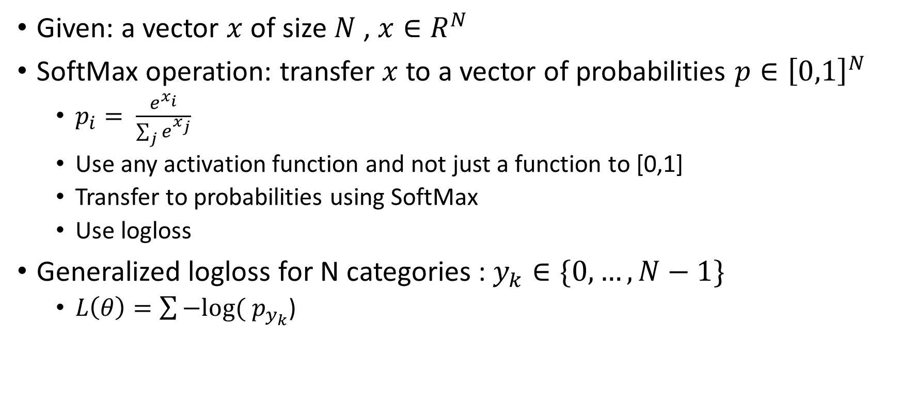
The SoftMax function
Given: a vector $x$ of size $N$ , $x∈R^{N}$
SoftMax operation: transfer $x$ to a vector of probabilities $p∈{\left[0,1\right]}^{N}$
$p_{i}= \frac{e^{x_{i}}}{\sum_{j}{e^{x_{j}}}}$
Use any activation function and not just a function to [0,1]
Transfer to probabilities using SoftMax
Use logloss
Generalized logloss for N categories : $y_{k}∈\{0,…,N−1\}$
$L\left(θ\right)=\sum{−log⁡( p_{y_{k}}}$)

Slide 10
So what is “deep” learning???
Big datasets
Deeper networks – more than 1 hidden layer.
Larger – many neurons in a layer.
Different activation functions (ReLU, LeakyReLU)
Better initialization using autoencoders (learn also from unlabeled data !)
Convolutional networks (Image and speech processing)
Better convergence tricks (Regularization, DropOut, Batch-Normalization)
Transfer Learning
Very efficient parallel code (often on GPUs), Lots of CPU power
More (RNN, Reinforcement networks, and many more variants)

Slide 11
Activation function

Slide 12
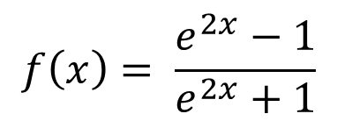
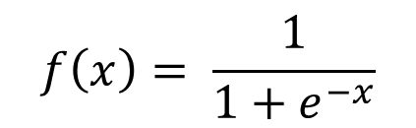
Activation functions - classical
$$f\left(x\right)= \frac{1}{1+e^{−x}}$$
$$f\left(x\right)= \frac{e^{2x}−1}{e^{2x}+1}$$
Not zero centered
Gradients diminish on sides
Zero Centered (nice)
Gradients still small on sides

Slide 13
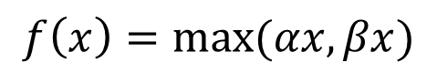
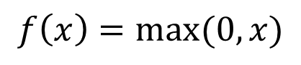
Activation functions – current standards
$$f\left(x\right)=\max{(0,x)}$$
$$f\left(x\right)=max⁡(αx,βx)$$
Gradient works on a wide range if x>0
Very fast computation
Easy differential
Typically α=0.01,0.1 β=1
Non Linear – with gradient working on both sides (!)

Slide 14
How many weights?
3 inputs , fully connected network
Layer1: (3+1)*4 = 16
Layer2: (4+1)*4 = 20
Output: (4+1)*1 = 5
Total: 41 weights
Modern CNNS: ~100M weights…

Slide 15
Live example…
Courtesy of Google…(search tensorflow playground)
live network

Slide 16
Typical training recipe
Prepare input vectors x
Typically have to impute missing data
Normalize to N(0,1)
Choose network topology (#layers, size of each layer)
Initialize
Random
Autoencoders
Transfer learning
Search for good meta parameters (learn rate, regularization, momentum, batch size, dropout probability) on a small subset
Train on whole set – typically a few times and then average or choose best.
Monitor train/test performance each Epoch (pass over all data)
Slowly decrease learning rate with “time”

Slide 17
Monitoring progression

Slide 18


Convolutions
Convolutions are long known filtering mechanism in image processing.

Slide 19
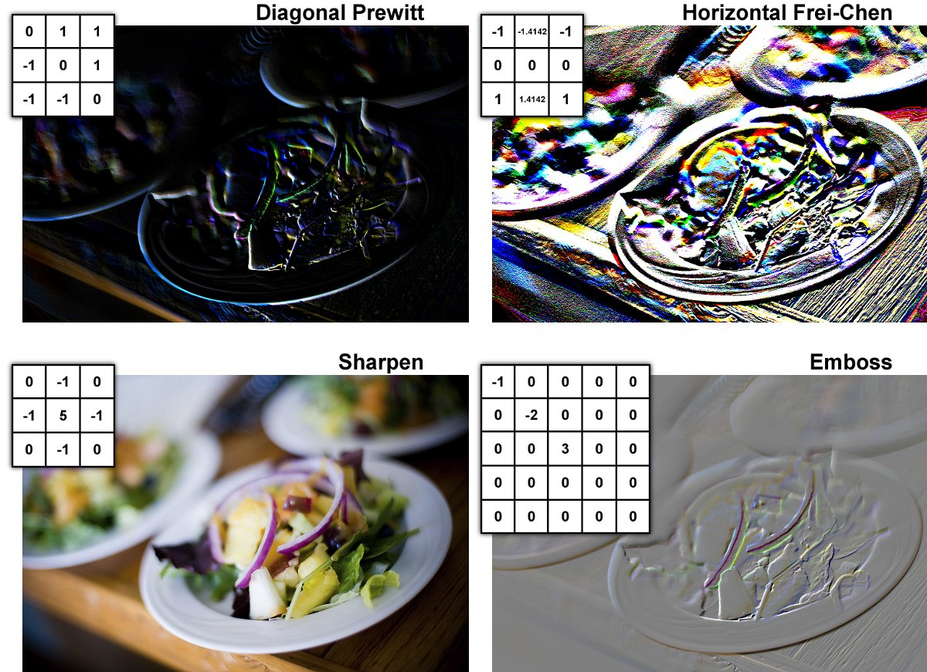
Convolutions
Small conv matrix
3 x 3
5 x 5
Typically zero sum
But not a must
Same operation , using the same matrix on all locations
Independence from location (!)
Same ideas also in signal processing (time x spectrum)
Can we machine learn convolutions?

Slide 20
Convolutional Layer
Starting with images of size width x height
Depth is the color space – R,G,B (or Y,U,V)
In layers beyond the input new objects of different height, weight and depth will be created
Convolutions
Sampling

Slide 21
Convolutional Layer
Neuron parameters:
5x5 convolution size (just an example)
Can use all depth or only one (typical – all)
Hence – 5x5x3 + 1 (bias) parameters (76)
A neuron for each position in the image
Learns only local features
32x32 neurons ….
32x32x76 parameters = 77824…
A fully connected neuron would have 32x32x3+1 parameters (3073)
Bad Idea
A neuron with shared weights for all positions
Learns features independent of location
5x5x3 + 1 parameters only (76) !
Typically to speed up image will be subsampled in some stride for inputs to the neuron
Learn many such neurons in the layer
Each is a new “color” learned
Very effective

Slide 22
Convolutional Layer
Key Ideas
Shared Parameters
Location independence
Learn many different convolutions
Next Steps
Use each learned filter on input
Create a “color” slice which will be the input to next layer
Subsample/maxpool slice
Place another Conv layer
OR a fully connected layer and go to softmax

Slide 23
Convolutional Layer – Max Pooling
Other options
Average
Stochastic
Fractional (Ben Graham)
To backpropagate
Remember which was the max
Or split in average pooling

Slide 24
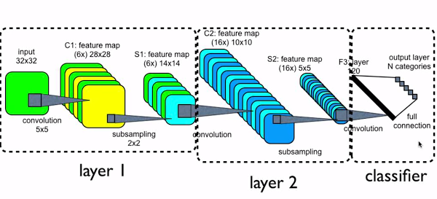
Convolutional Neural Nets
6 filters
Weights: (5x5+1)x6 = 156
Size: 28x28 (why?)
Maxpool size: 14x14 (why?)
16 filters
Weights: (5x5+1)*16 = 416
Size: 10x10
Maxpool size: 5x5
Fully Connected layer 120 neurons
Input size: 16x5x5 = 400
Weights: 401x120 = 48120
Last layer for 10 Categories
10 neurons
Weights: 121x10 = 1210

Slide 25
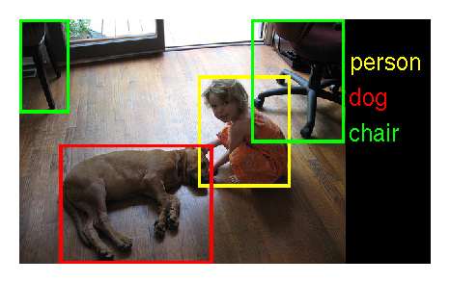
VGGNET – example of a large model
200 categories
Train : 500k images
Test: 20k images
Validation: 60k images
Top-1 err: 0.244
Top-5 err: 0.072

Slide 26
Convolutional Neural Networks

Slide 27
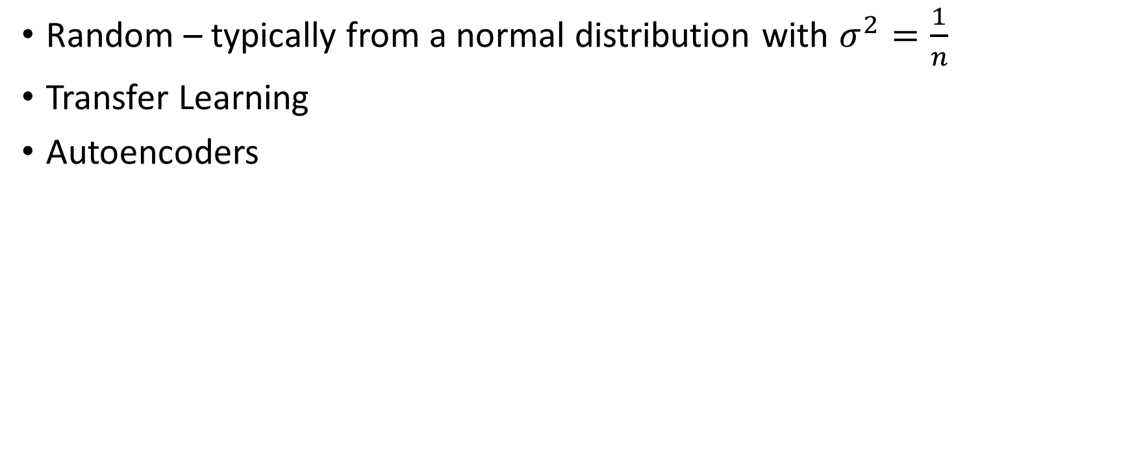
Initialization
Random – typically from a normal distribution with $σ^{2}=\frac{1}{n}$
Transfer Learning
Autoencoders

Slide 28
Transfer Learning

Slide 29
Autoencoders
Pretrain network with an Unsupervised step (!)
How?
Start with input data
Pass through a hidden layer (or a few)
Add a layer that reconstructs input
Minimize norm distance between input and reconstruction
Were a breakthrough a few years ago – significant improvements
Currently less used
Using Transfer learning
ReLU CNNs seem to be able to get the same results even without pretraining.

Slide 30
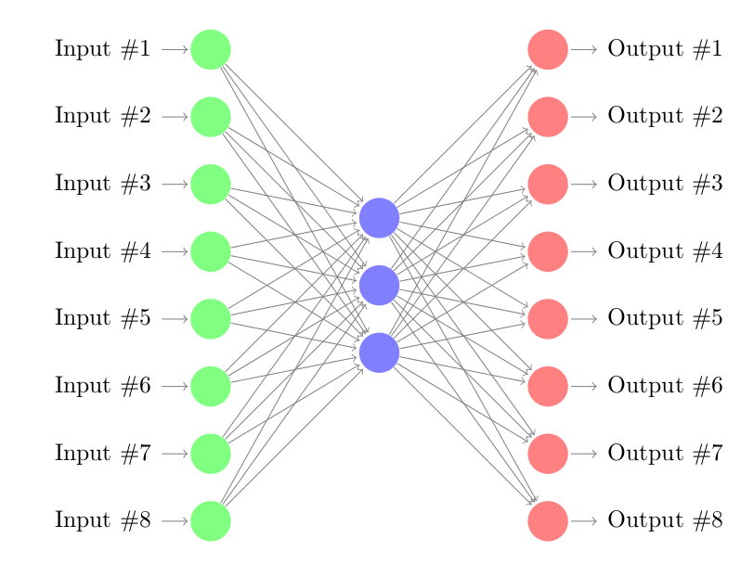
Autoencoders
What should the hidden layer size be?
Regularization:
Smaller number of neurons
Strong Ridge/Lasso
Add noise – compare to non noise
Reconstruct all from just a part of the data
Choose a random input subset in each train step
Train deeper autoencoders (2-3 is common)
Learns basic structures of the data fitting ALL classification future questions.
Enables us to use the unlabeled part of the data !

Slide 31
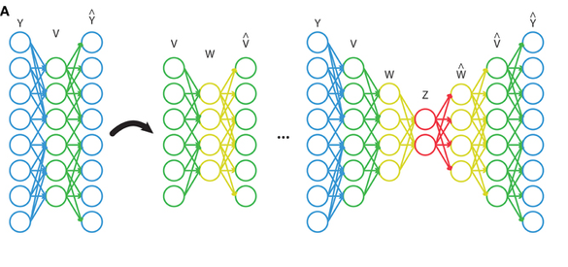
Stacked Autoencoders

Slide 32
Some more tricks - DropOut
In each step forward/backward
Choose a random set of neurons (prob p)
Train only with those
Update only their weights
In Test – multiply input to each layer by p
Acts as a very efficient regularizer
Widely used
Some variants exist
DropConnect
Typical probs:
0.8 for input layers
0.5 for inner layers

Slide 33
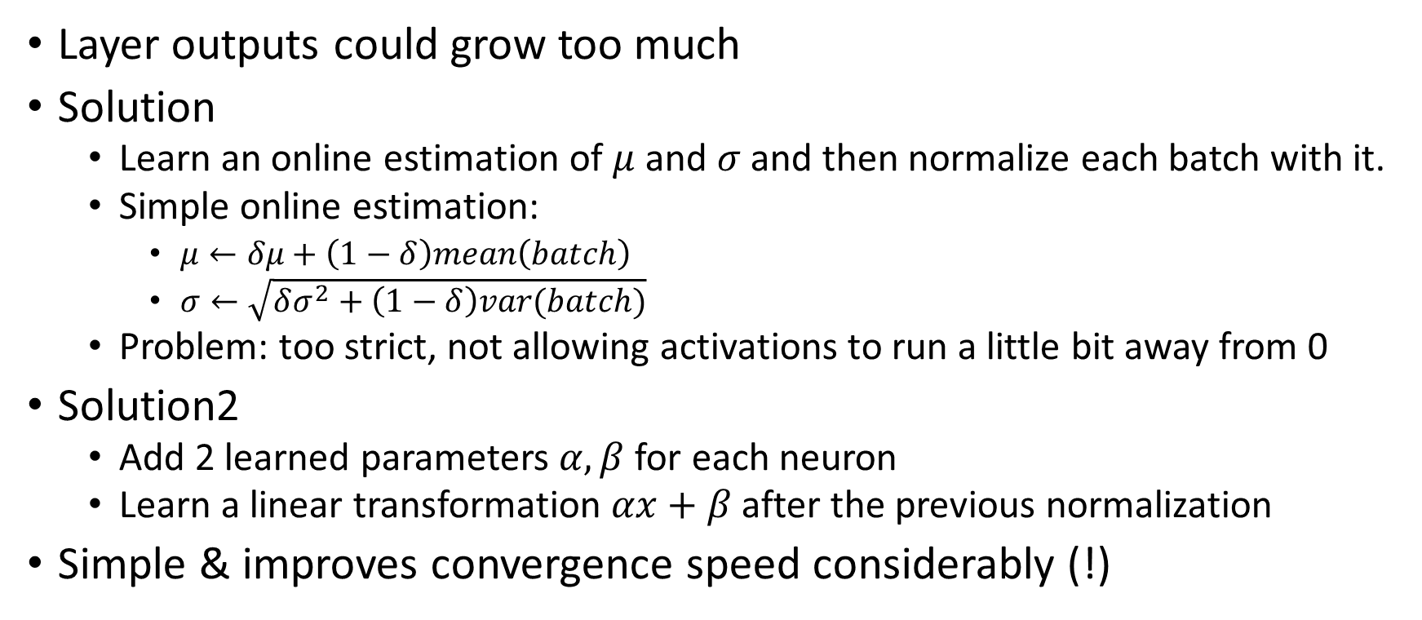
Some more tricks – Batch normalization
Layer outputs could grow too much
Solution
Learn an online estimation of $μ$ and $σ$ and then normalize each batch with it.
Simple online estimation:
$μ←δμ+\left(1−δ\right)mean\left(batch\right)$
$σ←\sqrt{δσ^{2}+\left(1−δ\right)var(batch)}$
Problem: too strict, not allowing activations to run a little bit away from 0
Solution2
Add 2 learned parameters $α,β$for each neuron
Learn a linear transformation $αx+β$after the previous normalization
Simple & improves convergence speed considerably (!)

Slide 34
Some more tricks – data augmentation
Add noise to data
Flip images, rotate, subsample, blur, sharpen, stretch
Change colors

Slide 35
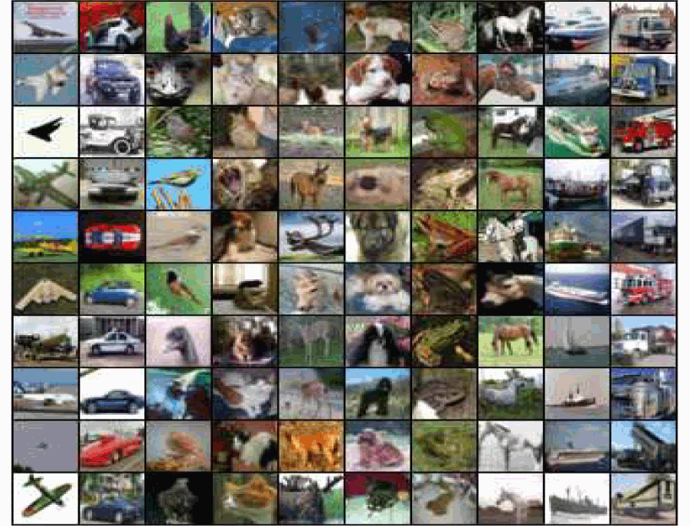
Some results – Cifar 10 Dataset
32x32 RGB images
10 classes
50k train, 10k test
Dog , Cat, Ship, Horse, Plane,…
Classical methods:
Generate Classical Image processing Features
Use SVM, RF, to classify
<60% accuracy

Slide 36
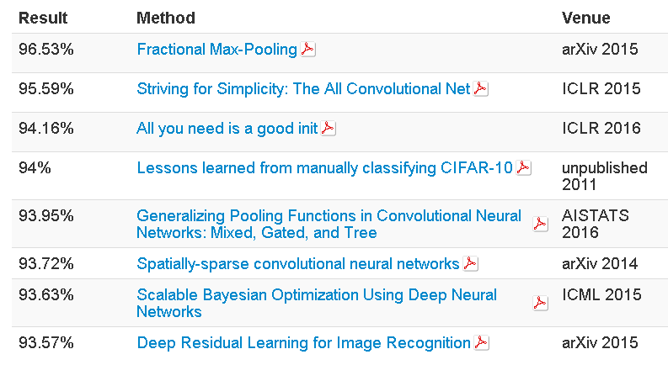
Cifar10 CNN results

Slide 37
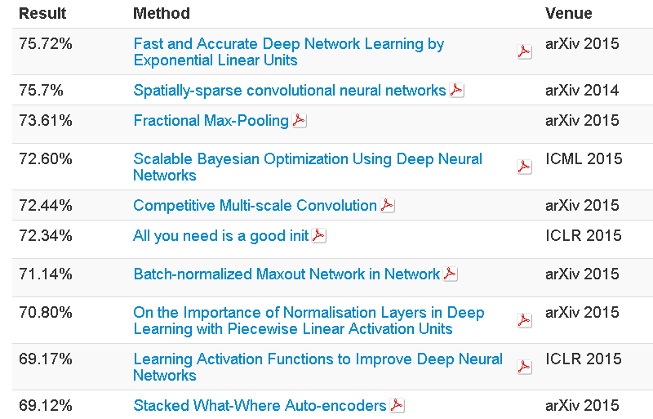
Cifar100 - Harder

Slide 38
Inside CNNs – Visualizing CNNs

Slide 39
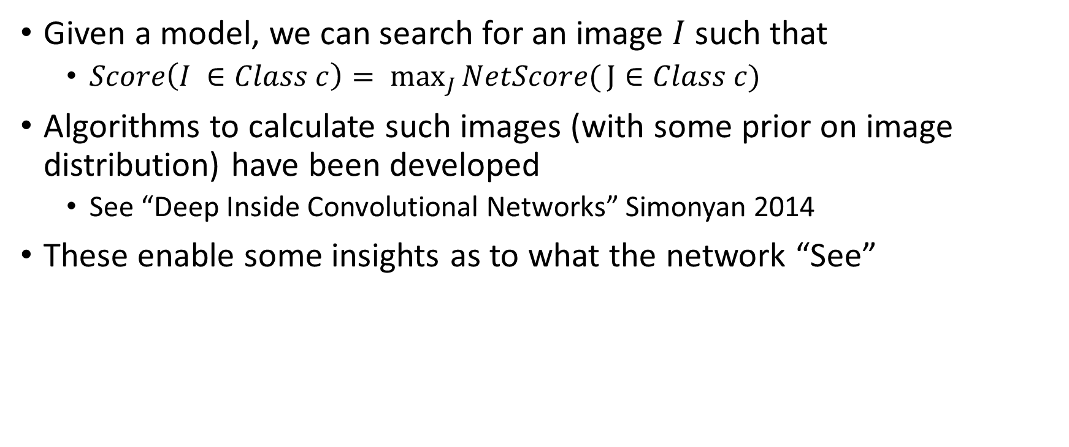
Inside CNNs – max score images
Given a model, we can search for an image $I$ such that
$Score\left(I ∈Class c\right)= \max_{J}{NetScore(}J∈Class c)$
Algorithms to calculate such images (with some prior on image distribution) have been developed
See “Deep Inside Convolutional Networks” Simonyan 2014
These enable some insights as to what the network “See”

Slide 40
Inside CNNs – max score images

Slide 41
Inside CNNs - Reconstruction
Run an Image through the network
At each layer try to reconstruct the image that maximized the output to the layer (or many layers after)
Without looking at the original image of course…
Using some “normality” prior on the image

Slide 42
Inside CNNS - reconstructions
From last pooling layer

Slide 43
Inside CNNs - Reconstructions

Slide 44
Inside CNNs – single neurons detection
Top scoring regions in test set
6 different neurons
From a deep layer

Slide 45
Fooling CNNs
What if we find the minimal change in an image to make it switch a class ?
“Intriguing properties of neural networks” [Szegedy at al]

Slide 46
Fooling CNNs

Slide 47
Fooling CNNs
Noise tailored to a specific network
Very different from human understanding
Effect can be improved with noise addition in training and testing

Slide 48
Deep Learning packages
Recommended – write a simple one on your own to understand it better.
Use public tools :
Excellent python packages:
Theano – open source, the community standard.
TensorFlow (by Google)
Both have GPU accelerated code options.

Slide 49
Thanks

